Slide 1


Reasoning on Knowledge Graphs: Symbolic or Neural?
Meng Qu^{1,2}, Zhaocheng Zhu^{1,2}, Jian Tang^{1,3,4}
Mila-Quebec AI Institute¹
University of Montreal²
CIFAR AI Chair³, HEC Montreal⁴
Feb 23, 2022

Slide 2
Summary
Part I: Neural Methods
Part II: Symbolic Logic Methods
Part III: Neural-Symbolic Methods
Part IV: Logic Rule Induction Methods
Part V: Summary and Future Directions

Slide 3
Summary
Part I: Neural Methods
Knowledge graph embedding:
TransE, ComplEx, RotatE, QuatE
Graph neural networks:
RGCN, GraIL

Slide 4
Summary
Part II: Symbolic Logic Methods
Bayesian logic programming:
Markov logic programming:
Markov logic networks
Stochastic logic programming:
TensorLog

Slide 5
Summary
Part III: Neural-Symbolic Methods
Markov logic programming:
pLogicNet
Stochastic logic programming:
ProPPR

Slide 6
Summary
Part IV: Logic Rule Induction Methods
RNNLogic, Differentiable ILP
NBFNet, NeuralLP
DeepPath

Slide 7
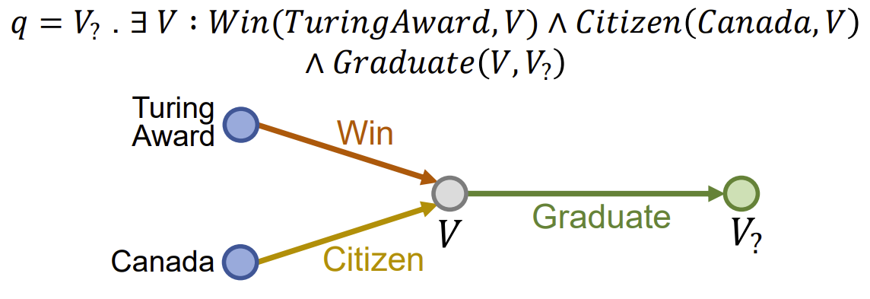
Complex Logical Query Answering
Answer complex logical query on knowledge graphs
Conjunction $∧$, disjunction $∨$, negation $¬$
Where did Canadian citizens with Turing Award graduate?
Learn relation projection and logical operations in the embedding space
Hongyu Ren, Weihua Hu, and Jure Leskovec. Query2box: Reasoning over knowledge graphs in vector space using box embeddings. ICLR 2020

Slide 8
Natural Language Processing
Knowledge graph reasoning has many applications in NLP:
Knowledge injection in pre-trained language models
Question-answering with knowledge graphs
Knowledge base probing

Slide 9
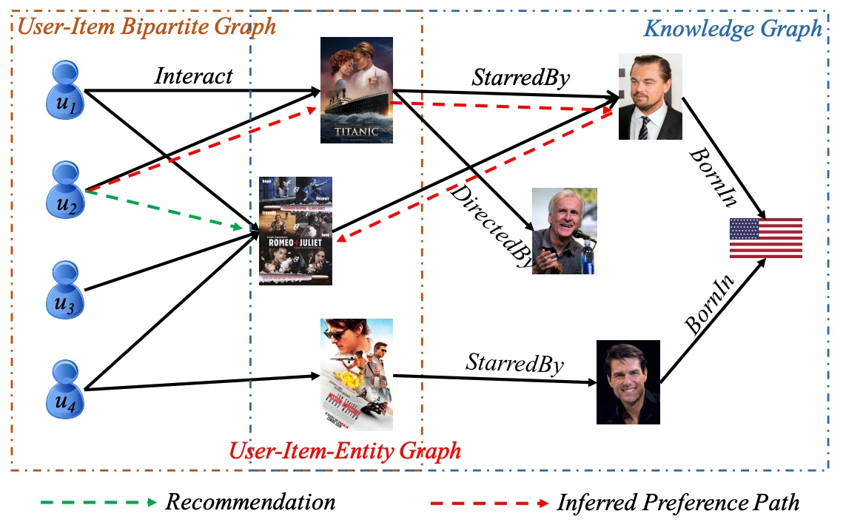
Recommendation
Recommender systems aim to recommend items to users based on historical data
Some knowledge graphs between items often exist
$$WillBuy\left(X,Y\right)←Buy\left(X,Z_{1}\right)∧StarredBy\left(Z_{1},Z_{2}\right)$$
$$∧StarredBy\left(Y,Z_{2}\right)$$
Weiping Song, et al. Explainable knowledge graph-based recommendation via deep reinforcement learning. arXiv 2019.

Slide 10
Drug Discovery
Drug repurposing
Given a disease, find a therapeutic drug
Target identification
Given a drug, find its target proteins
Can be directly modeled by embeddings or GNNs
Xiangxiang Zeng et al. Repurpose open data to discover therapeutics for COVID-19 using deep learning. Journal of proteome research 2020.

Slide 11
Other Topics
Few-shot Learning
Can we reason with a few limited number of facts for each relation
Combining System I and II reasoning
Knowledge graph reasoning are mainly System II reasoning
How to integrate with system I (perception)

Slide 12
Thanks!
Contact: meng.qu@umontreal.ca zhaocheng.zhu@umontreal.ca jian.tang@hec.ca

